Slide 1
Contributions to System Reliability Assessment and Bayesian Inverse Problems
Li Zhaohui
Supervisor:
Prof. Yu Dan(AMSS)
Prof. Tan Matthias Hwai-yong (Cityu)
Academy of mathematics and system sciences, CAS;
City University of Hong Kong

Slide 2
Outline
Introduction to System Reliability Assessment
Exact Method for System Reliability Assessment
R-WCF Expansion Method for System Reliability Assessment
Two-stage MCMC Method for Bayesian Inverse Problems with Functional Inputs

Slide 3
System Reliability Assessment

Slide 4
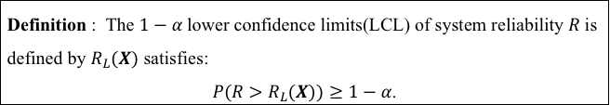
System Reliability Assessment
Statistical analysis for system reliability is an important issue discussed by statisticians and engineers for over six decades.
Statistical analysis : point estimation and confidence interval.
Point estimation for system reliability: Lack of measurement for uncertainty of parameter.
Main purpose of system reliability assessment: Determine the lower confidence limits of systems reliability using components testing data.
Definition : The $1−α$lower confidence limits(LCL) of system reliability $R$ is defined by $R_{L}(X)$ satisfies:
$P\left(R>R_{L}(X)\right)≥1−α$.

Slide 5
System Reliability Assessment
Components information
System information
Experimental data
Lifetime model
System structure
System reliability assessment
LCL of system reliability

Slide 6
System Reliability Assessment
Literature review
Bayesian method
Winterbottom(1984), Martz(1988)(1990), Hamada(2004),
benefit from proliferation of Markov chain Monte Carlo(MCMC)
Approximate method
WCF expansion: Winterbottom(1980)
Delta method and improvement: Yili Hong(2008),(2014)
Approximate accurate, based on the asymptotic theory in statistic.
Exact method
Buehler method: Buehler(1957);
Kabaila(2001)(2005), Fang(2005)
Engineering approach:
LM: Lindstrom & Madden(1962),
MML: Easterling(1972),
Equivalent method, have no specific statistical significance.

Slide 7
Buehler Confidence Limits
Challenges of system reliability assessment for mission critical systems:
High accuracy requirement;
Complex system structure;
Limited experimental data.
A procedure based on Buehler confidence limits surmount these problems.
Robert J Buehler. Confidence intervals for the product of two binomial parameters. JASA , 52(280):482–493, 1957.
Original method concentrated on series of two binomial components.

Slide 8
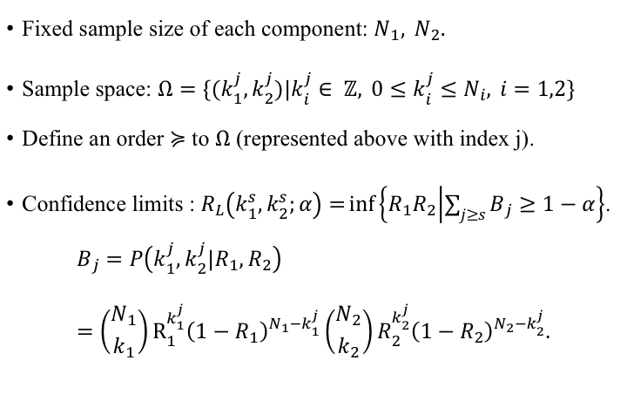
Buehler Confidence Limits
Fixed sample size of each component: $N_{1}, N_{2}.$
Sample space: $Ω=\{(k_{1}^{j},k_{2}^{j})|k_{i}^{j}∈ ℤ, 0≤k_{i}^{j}≤N_{i}, i=1,2\}$
Define an order $≽$ to $Ω$ (represented above with index j).
Confidence limits : $R_{L}\left(k_{1}^{s},k_{2}^{s};α\right)=\inf\left\{R_{1}R_{2} | \sum_{j≥s}{B_{j}}≥1−α\right\}$.
$$B_{j}=P\left(k_{1}^{j},k_{2}^{j}|R_{1},R_{2}\right) \\ =\left({N_{1} \atop k_{1}}\right)R_{1}^{k_{1}^{j}}{\left(1−R_{1}\right)}^{N_{1}−k_{1}^{j}}\left({N_{2} \atop k_{2}}\right)R_{2}^{k_{2}^{j}}{\left(1−R_{2}\right)}^{N_{2}−k_{2}^{j}}.$$
Notes:
Beginning of system reliability assessment.
Original procedures

Slide 9
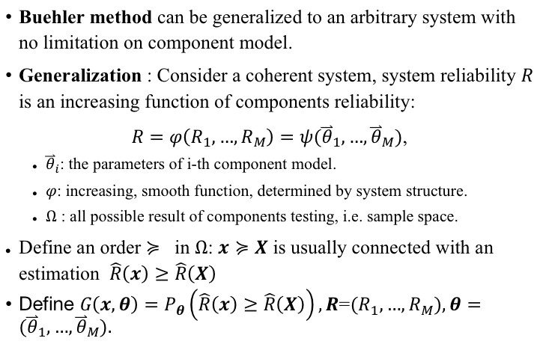
General Buehler Limits
Buehler method can be generalized to an arbitrary system with no limitation on component model.
Generalization : Consider a coherent system, system reliability $R$ is an increasing function of components reliability:
$R=φ\left(R_{1},…,R_{M}\right)=ψ({\overset{⃑}{θ}}_{1},…,{\overset{⃑}{θ}}_{M})$,
${\overset{⃑}{θ}}_{i}$: the parameters of i-th component model.
$φ$: increasing, smooth function, determined by system structure.
$Ω$ : all possible result of components testing, i.e. sample space.
Define an order $≽$ in $Ω$: $x≽X$ is usually connected with an estimation $\hat{R}\left(x\right)≥\hat{R}\left(X\right)$
Define $G\left(x,θ\right)=P_{θ}\left(\hat{R}\left(x\right)≥\hat{R}\left(X\right)\right),R\text{=}\left(R_{1},…,R_{M}\right),θ=({\overset{⃑}{θ}}_{1},…,{\overset{⃑}{θ}}_{M})\text{.}$

Slide 10
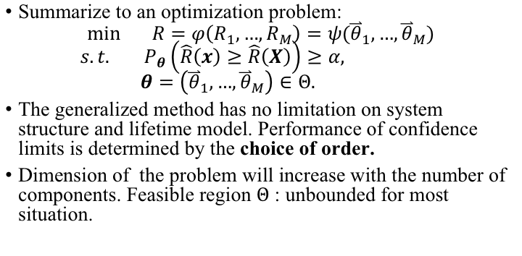
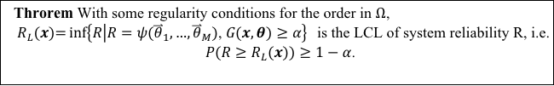
General Buehler Limits
Throrem With some regularity conditions for the order in $Ω$, ${ R}_{L}(x)={inf\left\{R | R=ψ({\overset{⃑}{θ}}_{1},…,{\overset{⃑}{θ}}_{M})\text{, }G(x,θ)≥α\right\}}$ is the LCL of system reliability R, i.e.
$P\left(R≥R_{L}(x)\right)≥1−α$.
Summarize to an optimization problem:
$$min R=φ\left(R_{1},…,R_{M}\right)=ψ({\overset{⃑}{θ}}_{1},…,{\overset{⃑}{θ}}_{M})$$
$$s.t. P_{θ}\left(\hat{R}\left(x\right)≥\hat{R}\left(X\right)\right)≥α,$$
$$θ=\left({\overset{⃑}{θ}}_{1},…,{\overset{⃑}{θ}}_{M}\right)∈Θ.$$
The generalized method has no limitation on system structure and lifetime model. Performance of confidence limits is determined by the choice of order.
Dimension of the problem will increase with the number of components. Feasible region $Θ$ : unbounded for most situation.

Slide 11
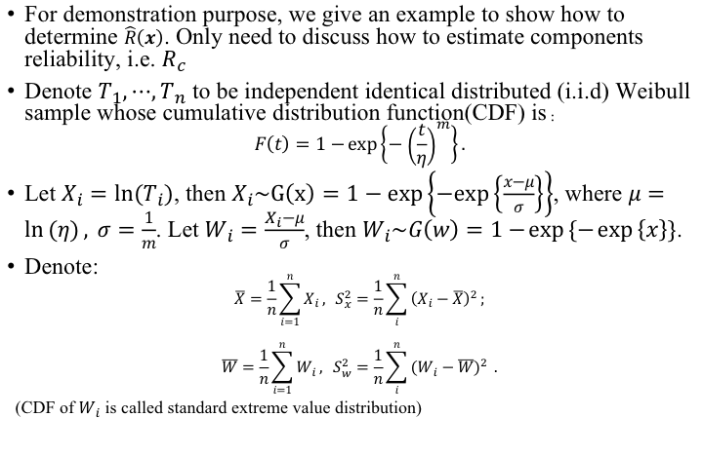

Determination of $\hat{R}\left(x\right)$
For demonstration purpose, we give an example to show how to determine $\hat{R}\left(x\right)$. Only need to discuss how to estimate components reliability, i.e. $R_{c}$
Denote $T_{1},⋯,T_{n}$ to be independent identical distributed (i.i.d) Weibull sample whose cumulative distribution function(CDF) is：
$$F\left(t\right)=1−\exp\left\{−{\left(\frac{t}{η}\right)}^{m}\right\}.$$
Let $X_{i}=ln⁡(T_{i})$, then $X_{i}\sim G\left(x\right)=1−exp\left\{−exp\left\{\frac{x−μ}{σ}\right\}\right\}$, where $μ=\ln\left(η\right), σ=\frac{1}{m}$. Let $W_{i}=\frac{X_{i}−μ}{σ}$, then $W_{i}\sim G\left(w\right)=1−\exp\left\{−\exp\left\{x\right\}\right\}$.
Denote:
$$\overline{X}=\frac{1}{n}\sum_{i=1}^{n}{X_{i}}, S_{x}^{2}=\frac{1}{n}\sum_{i}^{n}{{\left(X_{i}−\overline{X}\right)}^{2}};$$
$$\overline{W}=\frac{1}{n}\sum_{i=1}^{n}{W_{i}}, S_{w}^{2}=\frac{1}{n}\sum_{i}^{n}{{\left(W_{i}−\overline{W}\right)}^{2}} .$$
(CDF of $W_{i}$ is called standard extreme value distribution)

Slide 12
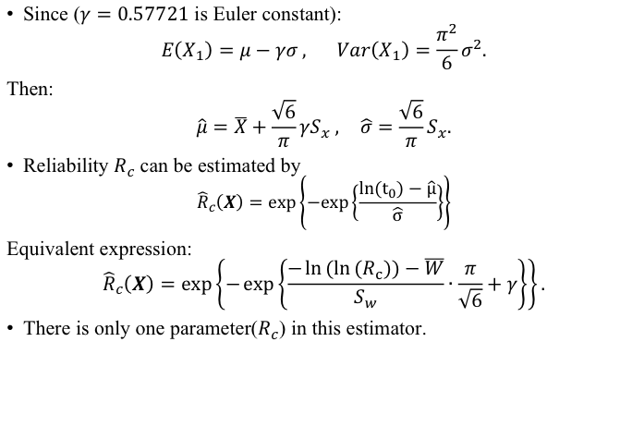
Determination of $\hat{R}\left(x\right)$
Since ($γ=0.57721$ is Euler constant):
$$E\left(X_{1}\right)=μ−γσ , Var\left(X_{1}\right)=\frac{π^{2}}{6}σ^{2}.$$
Then:
$$\hat{μ}=\overline{X}+\frac{\sqrt{6}}{π}γS_{x} , \hat{σ}=\frac{\sqrt{6}}{π}S_{x}.$$
Reliability $R_{c}$ can be estimated by
$${\hat{R}}_{c}\left(X\right)=exp\left\{−exp\left\{\frac{{ln(t}_{0})−\hat{μ}}{\hat{σ}}\right\}\right\}$$
Equivalent expression:
$${\hat{R}}_{c}\left(X\right)=exp\left\{−\exp\left\{\frac{−\ln\left(\ln\left(R_{c}\right)\right)−\overline{W}}{S_{w}}∙\frac{π}{\sqrt{6}}+γ\right\}\right\}.$$
There is only one parameter($R_{c}$) in this estimator.

Slide 13
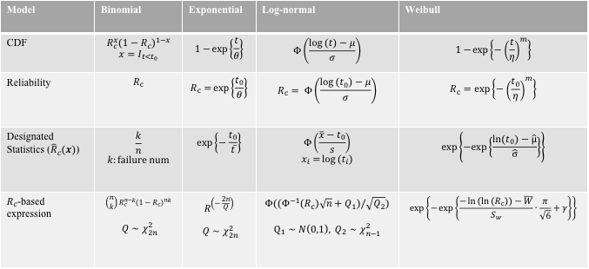
Determination of $\hat{R}\left(x\right)$
Some commonly used lifetime model has similar property. We give some suggestion on choice of ${\hat{R}}_{c}\left(x\right)$.
Model | Binomial | Exponential | Log-normal | Weibull
CDF | $$R_{c}^{x}{\left(1−R_{c}\right)}^{1−x}$$ $$x=I_{t<t_{0}}$$ | $$1−\exp\left\{\frac{t}{θ}\right\}$$ | $$Φ\left(\frac{\log\left(t\right)−μ}{σ}\right)$$ | $$1−\exp\left\{−{\left(\frac{t}{η}\right)}^{m}\right\}$$
Reliability | $$R_{c}$$ | $$R_{c}=\exp\left\{\frac{t_{0}}{θ}\right\}$$ | $$R_{c}= Φ\left(\frac{\log\left(t_{0}\right)−μ}{σ}\right)$$ | $$R_{c}=exp\left\{−{\left(\frac{t_{0}}{η}\right)}^{m}\right\}$$
Designated Statistics (${\hat{R}}_{c}\left(x\right)$) | $$\frac{k}{n}$$ $$k:failure num$$ | $$exp\left\{−\frac{t_{0}}{\overline{t}}\right\}$$ | $$Φ\left(\frac{\overline{x}−t_{0}}{s}\right)$$ $$x_{i}=\log\left(t_{i}\right)$$ | $$exp\left\{−exp\left\{\frac{{ln(t}_{0})−\hat{μ}}{\hat{σ}}\right\}\right\}$$
$R_{c}$-based expression | $$\left(\begin{aligned}n \\ k\end{aligned}\right)R_{c}^{n−k}{\left(1−R_{c}\right)}^{nk}$$ $Q∼χ_{2n}^{2}$ | $$R^{\left(−\frac{2n}{Q}\right)}$$ $Q∼χ_{2n}^{2}$ | $$Φ((Φ^{−1}\left(R_{c}\right)\sqrt{n}+Q_{1})/\sqrt{Q_{2}})$$ $$Q_{1}∼N\left(0,1\right), Q_{2}∼χ_{n−1}^{2}$$ | $$\exp\left\{−\exp\left\{\frac{−\ln\left(\ln\left(R_{c}\right)\right)−\overline{W}}{S_{w}}∙\frac{π}{\sqrt{6}}+γ\right\}\right\}$$
The point estimation has transformed the feasible region to a hypercube.

Slide 14
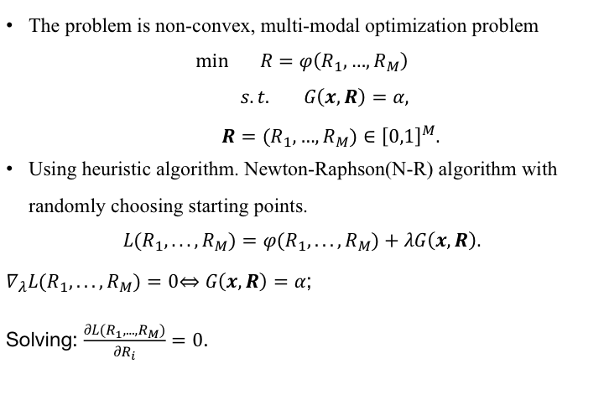
Algorithm
The problem is non-convex, multi-modal optimization problem
$$min R=φ\left(R_{1},…,R_{M}\right)$$
$$s.t. G\left(x,R\right)=α,$$
$$R=\left(R_{1},…,R_{M}\right)∈{\left[0,1\right]}^{M}.$$
Using heuristic algorithm. Newton-Raphson(N-R) algorithm with randomly choosing starting points.
$$L\left(R_{1},...,R_{M}\right)=φ\left(R_{1},...,R_{M}\right)+λG\left(x,R\right).$$
$∇_{λ}L(R_{1},...,R_{M})=0\overset{⇔}{}$ $G\left(x,R\right)=α$;
Solving: $\frac{∂L(R_{1},...,R_{M})}{∂R_{i}}=0$.

Slide 15
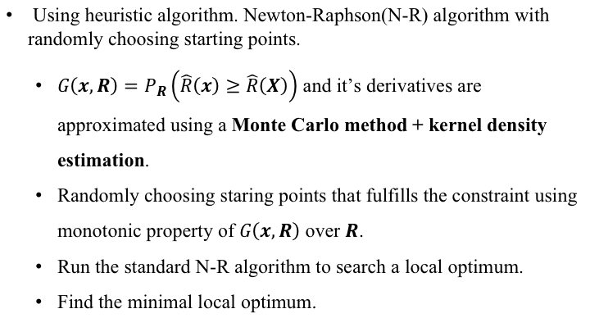
Algorithm
Using heuristic algorithm. Newton-Raphson(N-R) algorithm with randomly choosing starting points.
$G\left(x,R\right)=P_{R}\left(\hat{R}\left(x\right)≥\hat{R}\left(X\right)\right)$ and it’s derivatives are approximated using a Monte Carlo method + kernel density estimation.
Randomly choosing staring points that fulfills the constraint using monotonic property of $G\left(x,R\right)$ over $R$.
Run the standard N-R algorithm to search a local optimum.
Find the minimal local optimum.

Slide 16
Simulation
Three cases to illustrate the performance of proposed approach:
In order to compare the efficiency between our method and other widely used methods. Some applications to series system with binomial components are given to illustrate the advantage of proposed method. The results are compared to the normal table proposed by Lipow&Riley, WCF expansion.
LM (Lindtrom, Madden 1962), MML (Esterling, 1972) and AO (Mann 1974) are employed as comparison methods for very simple cases: series systems with binomial components.
Another simulation study gives a demonstration on applying to different components model, e.g. Weibull model and lognormal model. A series system consistent of three components with exponential, lognormal Weibull.
Mann R N and Frank E Grubbs. Approximately optimum confidence bounds for system reliability based on component test data. Technometrics, 16(3):335–347, 1974.
Easterling G R. Approximate confidence limits for system reliability. Journal of the American Statistical Association, 67(337):220–222, 1972.
Lindstrom, D. L. and Madden, J. H. (1962). In Lloyd, D. K. and Lipow, M., Reliability; Management, Methods and Mathenmatics, pp. 226-229. New York: Prentice-Hall

Slide 17
Simulation
Example of series system with binomial components( $α=0.1$ ):
Sample size | Failure number |  |  | Proposed | Norm (opt) | WCF
10 | 1 | 1 |  | 0.663 | 0.655 | 0.616
10 | 2 | 2 |  | 0.443 | 0.457 | 0.443
20 | 2 | 2 |  | 0.696 | 0.701 | 0.681
20 | 1 | 2 | 2 | 0.639 | 0.654 | 0.638
20 | 1 | 2 | 3 | 0.587 | 0.605 | 0.593
50 | 1 | 1 | 2 | 0.870 | 0.874 | 0.862
50 | 1 | 2 | 4 | 0.791 | 0.805 | 0.795
100 | 1 | 1 | 2 | 0.931 | 0.936 | 0.929
100 | 2 | 3 | 5 | 0.859 | 0.866 | 0.860

Slide 18
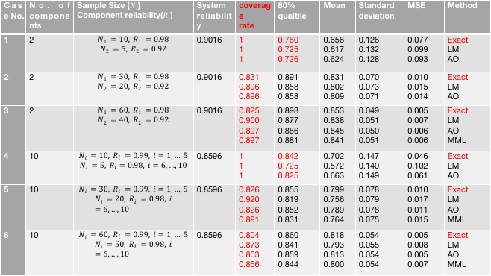
Simulation
Example of series system with binomial components ( $α=0.2$ ):
Case No. | No. of components | Sample Size ($N_{i}$) Component reliability($R_{i}$) | System reliability | coverage rate | 80% qualtile | Mean | Standard deviation | MSE | Method
1 | 2 | $$N1 =10, R1 =0.98$$ $$N2 =5, R2 =0.92$$ | 0.9016 | 1 1 1 | 0.760 0.725 0.726 | 0.656 0.617 0.624 | 0.126 0.132 0.128 | 0.077 0.099 0.093 | Exact LM AO
2 | 2 | $$N1 =30, R1 =0.98$$ $$N2 =20, R2 =0.92$$ | 0.9016 | 0.831 0.896 0.896 | 0.891 0.858 0.858 | 0.831 0.802 0.809 | 0.070 0.073 0.071 | 0.010 0.015 0.014 | Exact LM AO
3 | 2 | $$N1 =60, R1 =0.98$$ $$N2 =40, R2 =0.92$$ | 0.9016 | 0.825 0.900 0.897 0.897 | 0.898 0.877 0.886 0.881 | 0.853 0.838 0.845 0.841 | 0.049 0.051 0.050 0.051 | 0.005 0.007 0.006 0.006 | Exact LM AO MML
4 | 10 | $$Ni =10, R_{i} =0.99, i=1,…,5$$ $$Ni =5, R_{i}=0.98, i=6,…,10$$ | 0.8596 | 1 1 1 | 0.842 0.725 0.825 | 0.702 0.572 0.663 | 0.147 0.140 0.149 | 0.046 0.102 0.061 | Exact LM AO
5 | 10 | $$Ni =30, R_{i} =0.99, i=1,…,5$$ $$Ni =20, R_{i} =0.98, i=6,…,10$$ | 0.8596 | 0.826 0.920 0.826 0.891 | 0.855 0.819 0.852 0.831 | 0.799 0.756 0.789 0.764 | 0.078 0.079 0.078 0.075 | 0.010 0.017 0.011 0.015 | Exact LM AO MML
6 | 10 | $$Ni =60, R_{i} =0.99, i=1,…,5$$ $$Ni =50, R_{i} =0.98, i=6,…,10$$ | 0.8596 | 0.804 0.873 0.803 0.856 | 0.860 0.841 0.859 0.844 | 0.818 0.793 0.813 0.800 | 0.054 0.055 0.054 0.054 | 0.005 0.008 0.005 0.007 | Exact LM AO MML

Slide 19
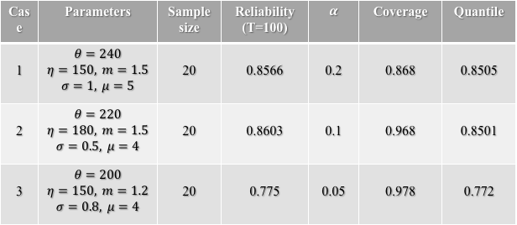
Simulation
Simulation for series system of three components with different lifetime models:
Case | Parameters | Sample size | Reliability (T=100) | $$α$$ | Coverage | Quantile
1 | $$θ=240$$ $$η=150, m=1.5$$ $$σ=1, μ=5$$ | 20 | 0.8566 | 0.2 | 0.868 | 0.8505
2 | $$θ=220$$ $$η=180, m=1.5$$ $$σ=0.5, μ=4$$ | 20 | 0.8603 | 0.1 | 0.968 | 0.8501
3 | $$θ=200$$ $$η=150, m=1.2$$ $$σ=0.8, μ=4$$ | 20 | 0.775 | 0.05 | 0.978 | 0.772
Notes:
Heuristic algorithm. Coverage probability,

Slide 20
Summary
Contributions:
Generalizing Buehler confidence limits to an arbitrary coherent system with new designated statistics, which provides the choice of order avoiding influence of nuisance parameters.
Heuristic algorithms are used to solve the optimization problem.
Future work :
More efficient and stable algorithms.

Slide 21
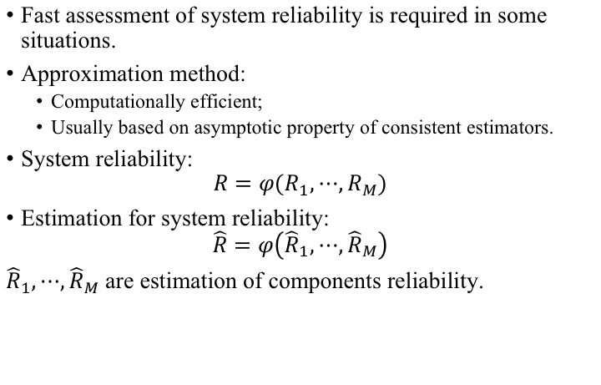
Approximation method for SRA
Fast assessment of system reliability is required in some situations.
Approximation method:
Computationally efficient;
Usually based on asymptotic property of consistent estimators.
System reliability:
$$R=φ\left(R_{1},⋯,R_{M}\right)$$
Estimation for system reliability:
$$\hat{R}=φ\left({\hat{R}}_{1},⋯,{\hat{R}}_{M}\right)$$
${\hat{R}}_{1},⋯,{\hat{R}}_{M}$ are estimation of components reliability.

Slide 22
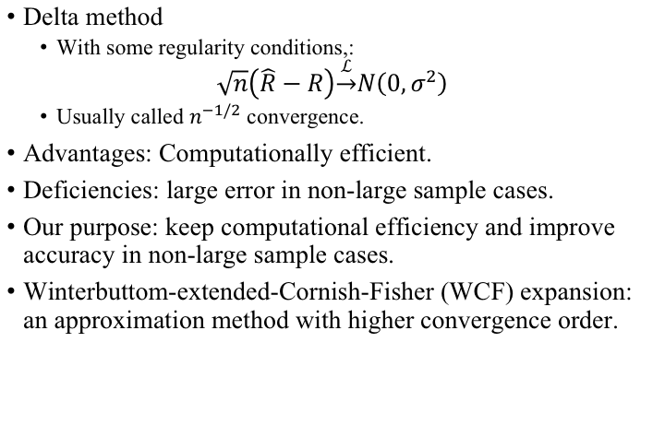
Approximation method for SRA
Delta method
With some regularity conditions,:
$$\sqrt{n}\left(\hat{R}−R\right)\underset{→}{ℒ}N\left(0,σ^{2}\right)$$
Usually called $n^{−1/2}$ convergence.
Advantages: Computationally efficient.
Deficiencies: large error in non-large sample cases.
Our purpose: keep computational efficiency and improve accuracy in non-large sample cases.
Winterbuttom-extended-Cornish-Fisher (WCF) expansion: an approximation method with higher convergence order.

Slide 23
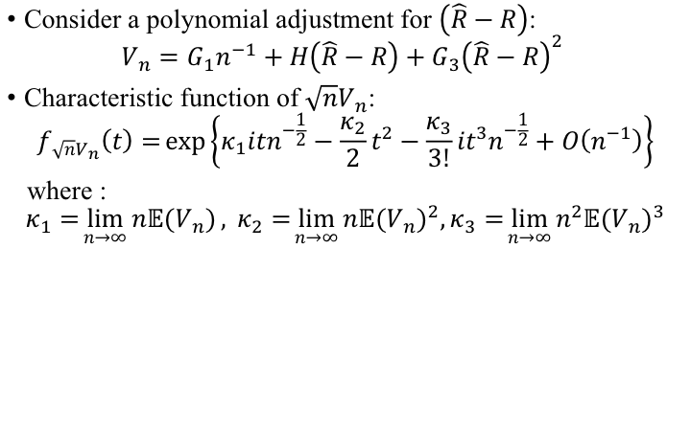
WCF expansion
Consider a polynomial adjustment for $\left(\hat{R}−R\right)$:
$$V_{n}=G_{1}n^{−1}+H\left(\hat{R}−R\right)+G_{3}{\left(\hat{R}−R\right)}^{2}$$
Characteristic function of${\sqrt{n}V}_{n}$:
$$f_{{\sqrt{n}V}_{n}}\left(t\right)=\exp\left\{κ_{1}itn^{−\frac{1}{2}}−\frac{κ_{2}}{2}t^{2}−\frac{κ_{3}}{3!}it^{3}n^{−\frac{1}{2}}+O\left(n^{−1}\right)\right\}$$
where :
$$κ_{1}=\lim_{n→∞}{n𝔼\left(V_{n}\right)}, κ_{2}=\lim_{n→∞}{n𝔼{\left(V_{n}\right)}^{2},}κ_{3}=\lim_{n→∞}{n^{2}𝔼{\left(V_{n}\right)}^{3}}$$

Slide 24
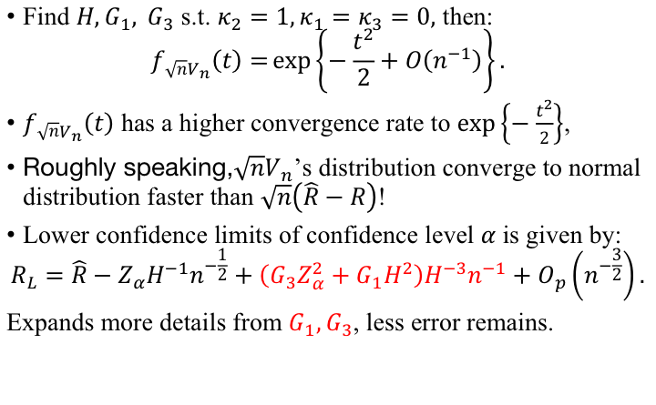
WCF expansion
Find $H,G_{1}, G_{3}$ s.t. $κ_{2}=1,κ_{1}=κ_{3}=0,$ then:
$$f_{{\sqrt{n}V}_{n}}\left(t\right)=\exp\left\{−\frac{t^{2}}{2}+O\left(n^{−1}\right)\right\}.$$
$f_{{\sqrt{n}V}_{n}}\left(t\right)$ has a higher convergence rate to $\exp\left\{−\frac{t^{2}}{2}\right\}$,
Roughly speaking,$\sqrt{n}V_{n}$’s distribution converge to normal distribution faster than $\sqrt{n}\left(\hat{R}−R\right)$!
Lower confidence limits of confidence level $α$ is given by:
$$R_{L}=\hat{R}−Z_{α}H^{−1}n^{−\frac{1}{2}}+\left(G_{3}Z_{α}^{2}+G_{1}H^{2}\right)H^{−3}n^{−1}+O_{p}\left(n^{−\frac{3}{2}}\right).$$
Expands more details from $G_{1},G_{3}$, less error remains.

Slide 25
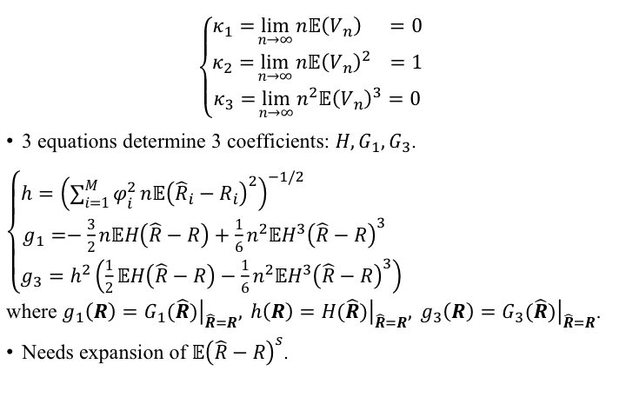
WCF expansion
$$\left\{\begin{aligned}κ_{1}=\lim_{n→∞}{n𝔼\left(V_{n}\right)} =0 \\ κ_{2}=\lim_{n→∞}{n𝔼{\left(V_{n}\right)}^{2}} =1 \\ κ_{3}=\lim_{n→∞}{n^{2}𝔼{\left(V_{n}\right)}^{3}}=0 \end{aligned}\right.$$
3 equations determine 3 coefficients: $H,G_{1},G_{3}$.
$\left\{\begin{aligned}h={\left(\sum_{i=1}^{M}{φ_{i}^{2}}n𝔼{\left({\hat{R}}_{i}−R_{i}\right)}^{2}\right)}^{−1/2} \\ g_{1}=−\frac{3}{2}n𝔼H\left(\hat{R}−R\right)+\frac{1}{6}n^{2}𝔼H^{3}{\left(\hat{R}−R\right)}^{3} \\ g_{3}=h^{2}\left(\frac{1}{2}𝔼H\left(\hat{R}−R\right)−\frac{1}{6}n^{2}𝔼H^{3}{\left(\hat{R}−R\right)}^{3}\right)\end{aligned}\right.$
where $g_{1}\left(R\right)={\left.G_{1}(\hat{R})\right|}_{\hat{R}=R}, h\left(R\right)={\left.H(\hat{R})\right|}_{\hat{R}=R}, g_{3}\left(R\right)={\left.G_{3}(\hat{R})\right|}_{\hat{R}=R}$.
Needs expansion of $𝔼{\left(\hat{R}−R\right)}^{s}$.

Slide 26
Proposed R-WCF expansion
Deficiency of original WCF expansion:
Determination of adjustment coefficients requires asymptotic properties of point estimation, which is lack of theoretical support for some multi-dim parameter model.
Performance of WCF expansion is influenced by the choice of point estimations and expansion variables.
New approach suggests a perspective of estimation and expansion based on the components reliability:
Avoid the pollution by nuisance parameter;
Guarantee of efficiency of application to some multi-parameter lifetime model.

Slide 27
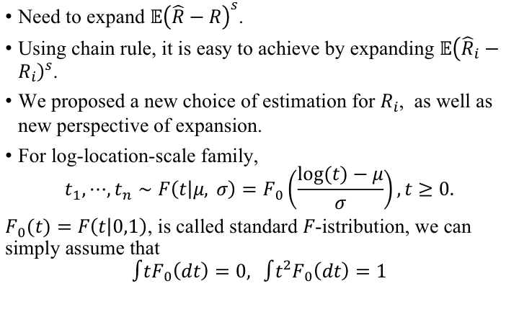
Proposed R-WCF expansion
Need to expand $𝔼{\left(\hat{R}−R\right)}^{s}$.
Using chain rule, it is easy to achieve by expanding $𝔼{\left({\hat{R}}_{i}−R_{i}\right)}^{s}$.
$\text{We} \text{proposed} \text{a} \text{new} \text{choice} \text{of} \text{estimation} \text{for} R_{i}\text{, }\text{as} \text{well} \text{as} \text{new} \text{perspective} \text{of} \text{expansion}\text{.}$
For log-location-scale family,
$$t_{1},⋯,t_{n}∼F\left(t | μ, σ\right)=F_{0}\left(\frac{log⁡(t)−μ}{σ}\right),t≥0.$$
$F_{0}(t)=F\left(t | 0,1\right)$, is called standard $F$-istribution, we can simply assume that
$$∫tF_{0}\left(dt\right)=0, ∫t^{2}F_{0}\left(dt\right)=1$$

Slide 28
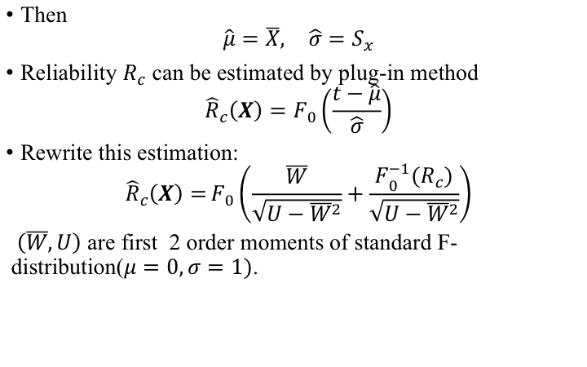
Proposed R-WCF expansion
Then
$$\hat{μ}=\overline{X}, \hat{σ}=S_{x}$$
Reliability $R_{c}$ can be estimated by plug-in method
$${\hat{R}}_{c}\left(X\right)=F_{0}\left(\frac{t−\hat{μ}}{\hat{σ}}\right)$$
Rewrite this estimation:
$${\hat{R}}_{c}\left(X\right)={F_{0}\left(\frac{\overline{W}}{\sqrt{U−{\overline{W}}^{2}}}+\frac{F_{0}^{−1}\left(R_{c}\right)}{\sqrt{U−{\overline{W}}^{2}}}\right)}$$
$\left(\overline{W},U\right)$ are first 2 order moments of standard F-distribution($μ=0,σ=1)$.

Slide 29
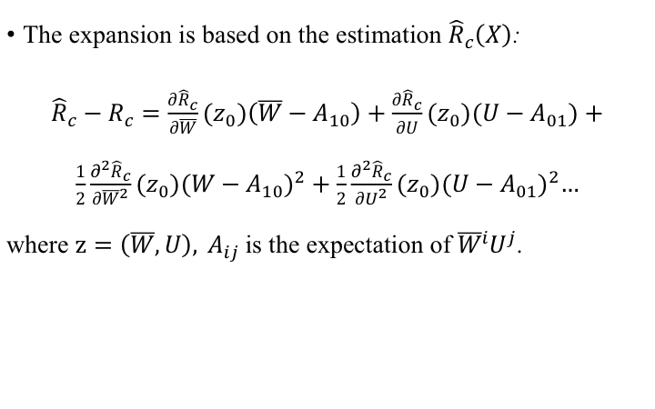
Proposed R-WCF expansion
The expansion is based on the estimation ${\hat{R}}_{c}\left(X\right)$:
${\hat{R}}_{c}−R_{c}=\frac{∂{\hat{R}}_{c}}{∂\overline{W}}(z_{0})\left(\overline{W}−A_{10}\right)+\frac{∂{\hat{R}}_{c}}{∂U}(z_{0})\left(U−A_{01}\right)+\frac{1}{2}\frac{∂^{2}{\hat{R}}_{c}}{∂{\overline{W}}^{2}}(z_{0}){\left(W−A_{10}\right)}^{2}+\frac{1}{2}\frac{∂^{2}{\hat{R}}_{c}}{∂U^{2}}\left(z_{0}\right){\left(U−A_{01}\right)}^{2}…$
where $z=\left(\overline{W},U\right){, A}_{ij}$is the expectation of ${\overline{W}}^{i}U^{j}$.

Slide 30
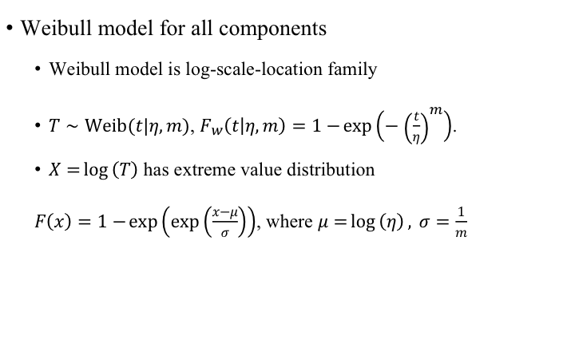
Simulation
Weibull model for all components
Weibull model is log-scale-location family
$T∼Weib(t|η,m)$, $F_{w}\left(t | η,m\right)=1−\exp\left(−{\left(\frac{t}{η}\right)}^{m}\right)$.
$X=\log\left(T\right)$ has extreme value distribution
$F\left(x\right)=1−\exp\left(\exp\left(\frac{x−μ}{σ}\right)\right)$, where $μ=\log\left(η\right), σ=\frac{1}{m}$

Slide 31
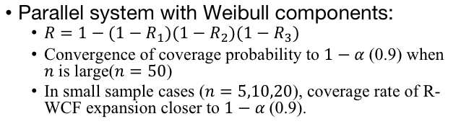
Simulation
Parallel system with Weibull components:
$R=1−(1−R_{1})(1−R_{2})(1−R_{3})$
Convergence of coverage probability to $1−α$ (0.9) when $n$ is large($n=50$)
In small sample cases ($n=5,10,20$), coverage rate of R-WCF expansion closer to $1−α$ (0.9).

Slide 32

Simulation
3-out-of-5 system (assume different components).
$$R=\prod_{i=1}^{5}{R_{i}}+\sum_{i=1}^{5}{\left(\frac{1−R_{i}}{R_{i}}\prod_{j=1}^{5}{R_{j}}\right)}+\sum_{1≤i<j≤5}{\left(\frac{(1−R_{i})(1−R_{j})}{R_{i}R_{j}}\prod_{j=1}^{5}{R_{j}}\right)}.$$

Slide 33
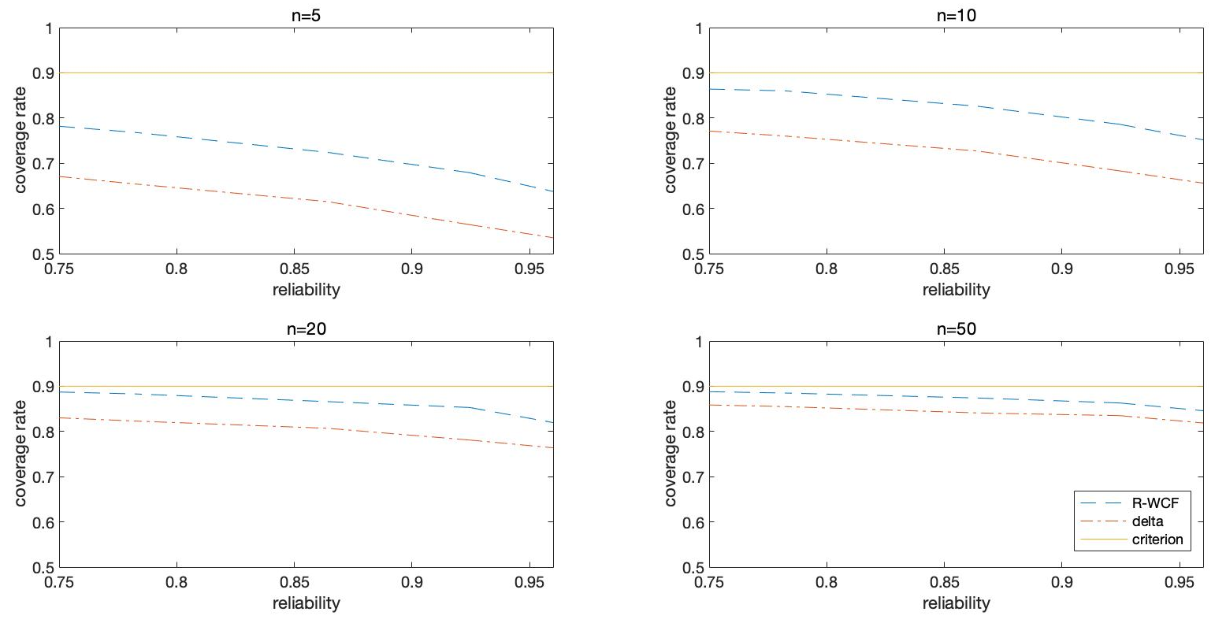
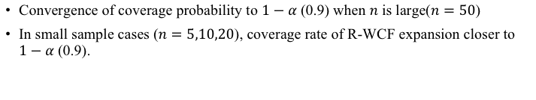
Simulation
Convergence of coverage probability to $1−α$ (0.9) when $n$ is large($n=50$)
In small sample cases ($n=5,10,20$), coverage rate of R-WCF expansion closer to $1−α$ (0.9).

Slide 34
Summary
Contributions:
Propose a framework for contracting high order approximation confidence limits for system reliability, adapt to log-location-scale components model.
Deficiency and Future works:
When parameters close to bounds of parameter space (e.g. reliability close to 1, ultra high reliability), asymptotic methods usually performs poor.
Extend to the cases with ultra high reliability systems.

Slide 35
Summary
Contributions:
We generate an efficient and accurate method for solving the Bayesian inverse problem for a functional input through
Employ a prior Gaussian process model for the functional input to be estimated with a nondegenerate prior for its correlation parameters.
Propose a two-stage integrated MCMC and emulator construction method that adaptively chooses the design points for the GP emulator based on an initial MCMC to reduce the effect of emulator prediction uncertainty on posterior inference.
Future work:
Design strategy for follow-up physical experiment in addition to a follow-up computer experiment.

